Slide 1

Lawrence House Museum

Slide 2
The Nova Scotia Museum
Provincial Museum
28 Museum sites across the province
  Directly Managed Museums (11)
  Locally Managed Museums (17)
Provincial ownership of building, collections. Oversight of museum operations.

Slide 3
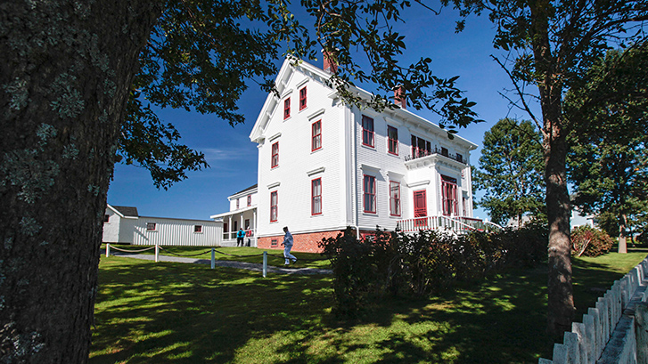
Lawrence House
Purchased by the province in 1967
Opened as a museum in 1971
Directly-managed museum
  Unionized government employees
  Revenues retained by province
  Site maintenance by province

Slide 4
Temporary Site Closure 2024
Decision to close Lawrence House Museum for 2024 was to provide an opportunity to review the site and make a plan to address key issues:
  Dwindling visitation
  Staffing pressures
  Lack of programs/events
  Public Response
  Community Frustrations

Slide 5
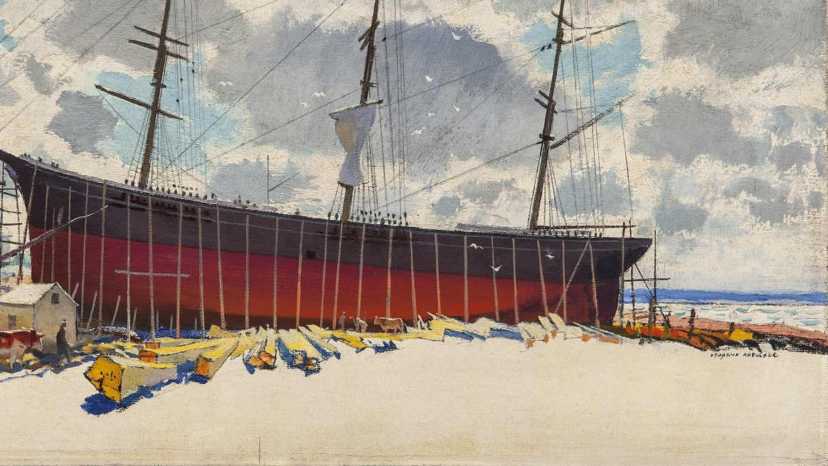
Meetings with Community Members- What we’ve heard
Lawrence House Museum is a valued community asset, however:
  Unpredictability of open hours has been a challenge
  Community members feel disconnected from site operations
    Desire for greater access for events
    Many members would like to be engaged with the museum, but have been discouraged in doing so.
  Site doesn’t feel welcoming
  Tourism is important, desire for museum to work with other attractions to enhance tourism experience
  Don’t want to lose Lawrence House, but also don’t want to return to way things have been.

Slide 6
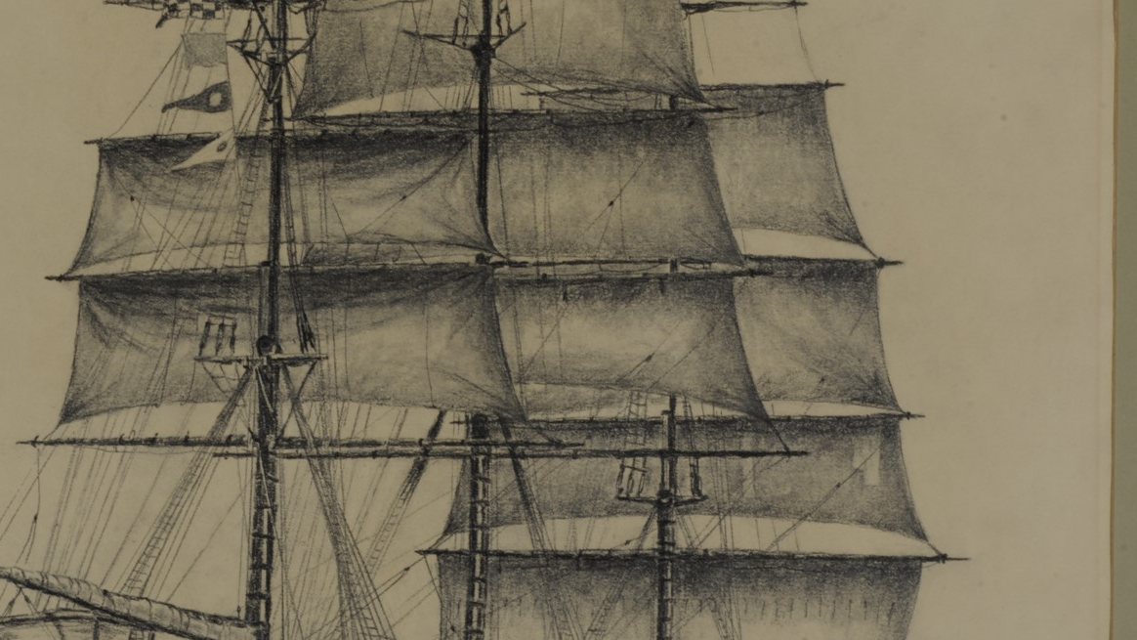
Opportunities
Lots of Community Engagement
Strong ties to the municipality
Grants may be available to support staffing, including students
Opportunity to connect and incorporate operations with other community assets to ensure needs are met.

Slide 7
Museum Model: Directly-Managed Provincial Site
Under this model, things at Lawrence House would stay much the same as they have been.
Staff would continue to work for province, site would follow Directly-Managed site hours of operation
PROS:
Retain provincial control of operation
CONS:
Province directly in control of all aspects of operation, including staffing, interpretation and programming.
Directly-managed sites do not retain revenues, so little opportunity for re-investment into the museum

Slide 8
Museum Model: Locally-Managed Provincial Site
Lawrence House would be retained as a provincial museum under the Nova Scotia Museum system.
The site would be overseen by a local management group (society/board or municipality).
  This group would have a license agreement with the province, the province would provide operational direction through an operations manual
  The province would provide an annual operating grant
Staff would not be employees of the province
PROS:
Community oversight of museum (including hours of operation, season length etc)
Reinvestment of revenues into museum
CONS:
Grant is a portion of operating costs, operating organization responsible to earn revenues
Province retains direction on interpretation, site use ect.

Slide 9
Museum Model: CMAP (Community Museum Assistance Program
Lawrence House would no longer be part of the provincial museum (Nova Scotia Museum).
The museum would be run by a community group, and receive an annual grant from the province.
The community group would have control over how museum operated
Province could maintain ownership and maintenance of building.
PROS:
Community directs operations of museum.
All revenue from operations retained in community
CONS:
Grant is a portion of operating costs, operating organization responsible to earn revenues

Slide 10
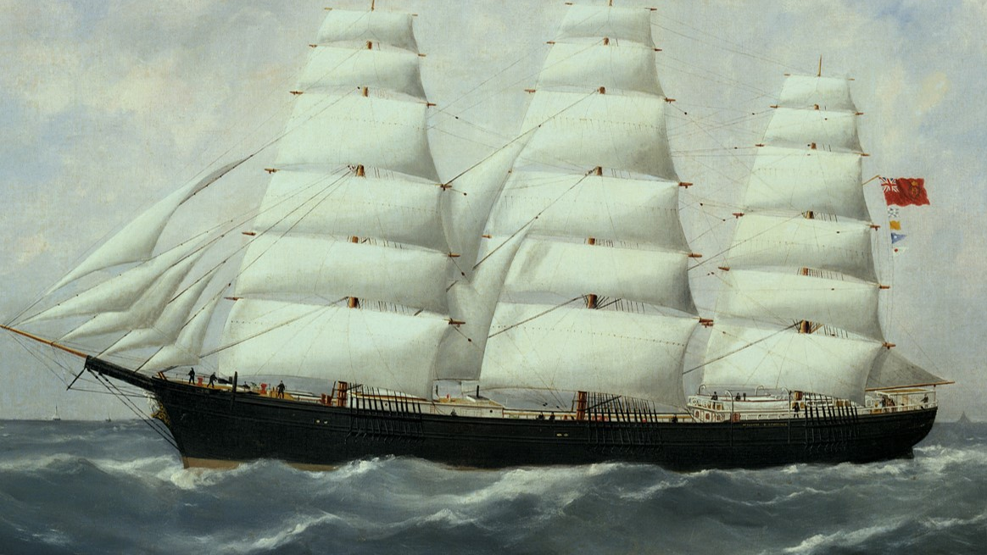
Other models
Other models of museum management exist (such as private ownership, municipal ownership, federal ownership)
Possible to explore some hybrid management models
What is most important to the community? What resources exist to support management of Lawrence House Museum?

Slide 11
Discussion

